Slide 1
ClaimSphere QaaS
Knowledge Sharing Session

Slide 2
Healthcare
Healthcare System
1. Health Plan
(UHG, CareFirst, etc.)
1. Enrollment
5. Payment
4. Claim
2. Members
(Subscriber & Dependent)
3. Providers
(Hospitals, Physicians, Lab, Pharmacy)
2. Patient
3. Treatment

Slide 3
Quality of care
National regulatory body
(CMS)
1. Health Plan
(UHG, CareFirst)
Accrediting Body
(NCQA)
5. Payment
1. Enrollment
4. Claim
2. Members
(Subscriber & Dependent)
3. Providers
(Hospitals, Physicians, Lab, Pharmacy)
State level regulatory body
2. Patient
3. Treatment

Slide 4
ClaimSphere™ QaaS
Health Plan
(UHG, CareFirst)
NCQA Certified Vendor
(ClaimSphere™
QaaS)
Quality Reporting
(NCQA, CMS, Any State agencies)

Slide 5
NCQA HEDIS®
https://www.ncqa.org/hedis/measures/
The Healthcare Effectiveness Data and Information Set (HEDIS) is one of the most widely used sets of health care performance measure in the United States.

Slide 6
NCQA HEDIS® 2025 Season
Retrospective Period
Jan 2024
Jul 1 2024
Dec 2024
June 2025
Measurement Year
NCQA HEDIS® Submission

Slide 7
NCQA HEDIS® 2026 Season
Prospective Period
Jan 2025
Dec 2025
June 2026
Measurement Year
NCQA HEDIS® Submission

Slide 8

Measure Anatomy
Rules
Eligible Population
Required Exclusion
Qualified Population
Measure
(in Percentage)
100
Denominator
Eligible Population
Numerator
Rules
Optional Exclusion

Slide 9
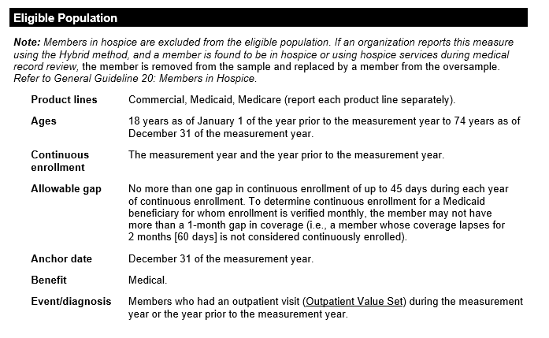
Measure Anatomy – Adult BMI Assessment

Slide 10
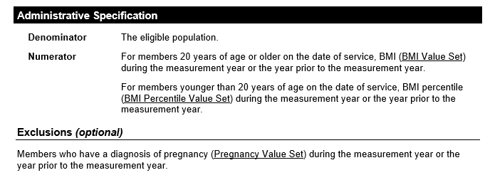
Measure Anatomy – Adult BMI Assessment

Slide 11
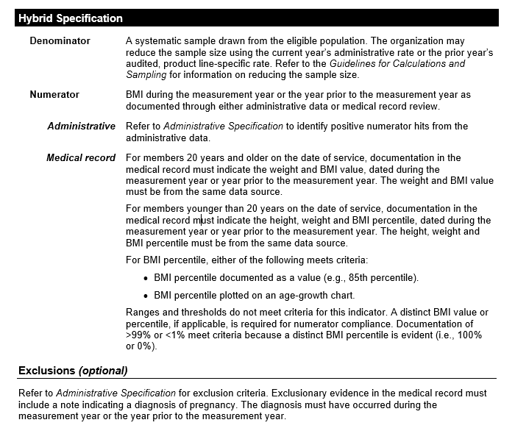
Measure Anatomy – Adult BMI Assessment

Slide 12
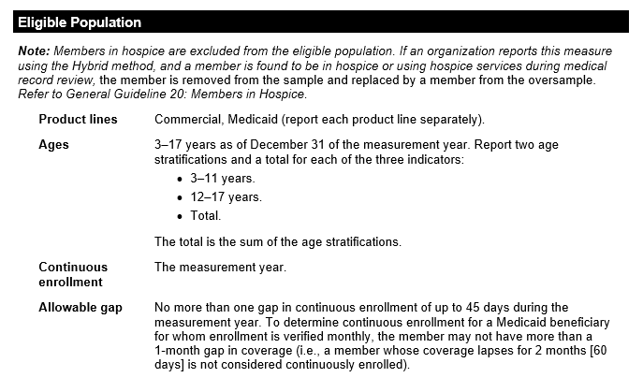
Measure Anatomy - WCC

Slide 13
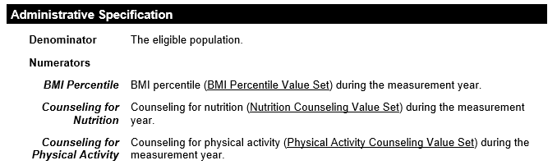

Measure Anatomy - WCC

Slide 14
Data Sources

Slide 15


Data Sources
Claims
(Visit, Lab, Pharmacy)
Member Enrollment Records
Provider info
Administrative data
Health plan
Lab Result file
EHR
Provider portal
Medical charts
Physician, Lab, Pharmacy
Supplemental data
Immunization records
External system
(Immunization Information System)

Slide 16
Supplemental Data Sources
Lab Result file
EHR
Provider portal
Medical charts
Physician, Lab, Pharmacy
Immunization records
External system
Standard Supplemental Data
Electronically generated files which follows clear policies and procedures and has standard file layouts, industry standard codes
Non-standard supplemental data
Data might be collected from sources on an irregular basis and could be in files or formats that are not stable over time

Slide 17
HEDIS® Data Sources
Points to remember
When evidence to support the measure is found in multiple data sources, a data hierarchy is applied (Supplemental data are considered last).
Supplemental data may help determine
Numerators.
Optional exclusions.
Required exclusions
Observed Events in the Risk Adjusted Utilization measures.
All nonstandard supplemental data requires proof-of-service documentation as part of the audit’s annual primary source verification.

Slide 18
ClaimSphere QaaS Workflow

Slide 19

Retrospective Administrative Workflow
Membership General
Enrollment
Visit
Pharmacy
Lab Observation
Provider Info
Member PCP
Supplemental
Admin Measure
Data Intake
(DQ, Cleansing)
Event Processing
Measure Processing
INPUT FILES
ClaimSphereTM NCQA Certified Measure Engine
Hybrid Measure Workflow
Notes:
Hybrid Workflow
Submission Workflow
Reporting Workflow

Slide 20
Hybrid Measure Workflow
Admin
Measure
Member Sampling
Chase Generation
Chase Request
“Inbound”
Files
Chart Abstraction Software
Hybrid
Measure
MRR Analytics
Chase Response
“Outbound”
Files

Slide 21
Regulatory Submission & Reporting Workflow
Regulatory Submission
IDSS File
PLD File
State Measure File
State Member file
CAHPS files
Admin
Measure
Hybrid
Measure
Measure Scorecard
Provider Scorecard
DQ Report
Measure rate report
Hybrid rate report
Dashboard
Reports

Slide 22
Prospective Measurement Workflow
Quality Improvement
StarSERV
STAR Interfaces , Proxy
Configurable STAR Dashboard
STAR Assessment
What IF Modelling
Cut Point Prediction
Measure Rate Prediction
Membership General
Enrollment
Visit
Pharmacy
Lab Observation
Provider Info
Member PCP
Supplemental
Batch Process
Admin
Measure
Event Processing
Measure Processing
Cohort Explorer
INPUT FILES
Cohort Interfaces
Cohort Library
Cohort Exploration
Population and Member Level Compliance Prediction
Population and Member Level Health Risk Prediction
ClaimSphereTM Extended Measure Library
Stream Interfaces
Stream Process
Near Real Time
Clinical+
Clinical+ Interfaces
Value Based Programs
Provider Registry
Supplemental Files

Slide 23
Clinical+ Workflow

Slide 24
Data Sources
Claims
(Visit, Lab, Pharmacy)
Member Enrollment Records
Provider info
Administrative data
Health plan
Clinical+
Lab Result file
Certified EHR System
Provider portal
Medical charts
Provider
Supplemental data
Immunization records
External system
(Immunization Information System)

Slide 25
Clinical+ Interfaces
ClaimSphere QaaS
Provider Specialty | Provider Info | Member General | Member Enrollment info | Member PCP attribution | Member Provider reporting hierarchy | Member care gaps
Clinical+
1
Clinical+ Workflow
Care Gap Assignment
Chart Abstraction
Medical Chart Upload
Review
Care gap closure
2
ClaimSphere QaaS
Clinical+
Generate “Pseudo Claims”
(Non Standard Supplemental Data File)
3

Slide 26
PPC Measure

Slide 27
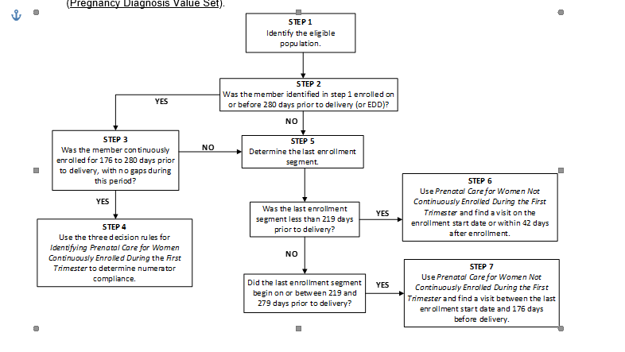

Slide 28
Member Delivery
20-Sep-2017
EDD – 280days
LMP
20-Nov-2017
EDD – 219days
2-Jan-2018
EDD – 176days
20-Jun-2018
DoD
27-Jun-2018
EDD
First Trimester
Second & Third Trimester

Slide 29
Continuously enrolled during the first trimester with no gaps
Prenatal Visit should be between 20th Sep 2017 and 2-Jan-2018
Enrollment start 20th Aug 2017
Enrollment end 2-Feb 2018
20-Sep-2017
EDD – 280days
LMP
20-Nov-2017
EDD – 219days
2-Jan-2018
EDD – 176days
20-Jun-2018
DoD
27-Jun-2018
EDD
First Trimester
Second & Third Trimester
Prenatal Visit should be during first trimester

Slide 30
Enrollment start between 279 & 219 days
Prenatal Visit should be between 20th Oct 2017 and 2-Jan-2018
Enrollment start 20th Oct 2017
20-Sep-2017
EDD – 280days
LMP
20-Nov-2017
EDD – 219days
2-Jan-2018
EDD – 176days
20-Jun-2018
DoD
27-Jun-2018
EDD
First Trimester
Second & Third Trimester
Prenatal Visit should be between enrollment start date and 176 days before delivery

Slide 31
Enrollment start less than 219 days from delivery
Prenatal Visit should be between 1-Feb-2018 and 3-Mar-2018
Enrollment start 1-Feb-2018
20-Sep-2017
EDD – 280days
LMP
20-Nov-2017
EDD – 219days
2-Jan-2018
EDD – 176days
20-Jun-2018
DoD
27-Jun-2018
EDD
First Trimester
Second & Third Trimester
Prenatal Visit should be on last enrollment start date or within 42 days after enrollment

Slide 32
Thank you

